Slide 1
Clean Code

Slide 2
Agenda
What’s Clean
Clean Code

Slide 3

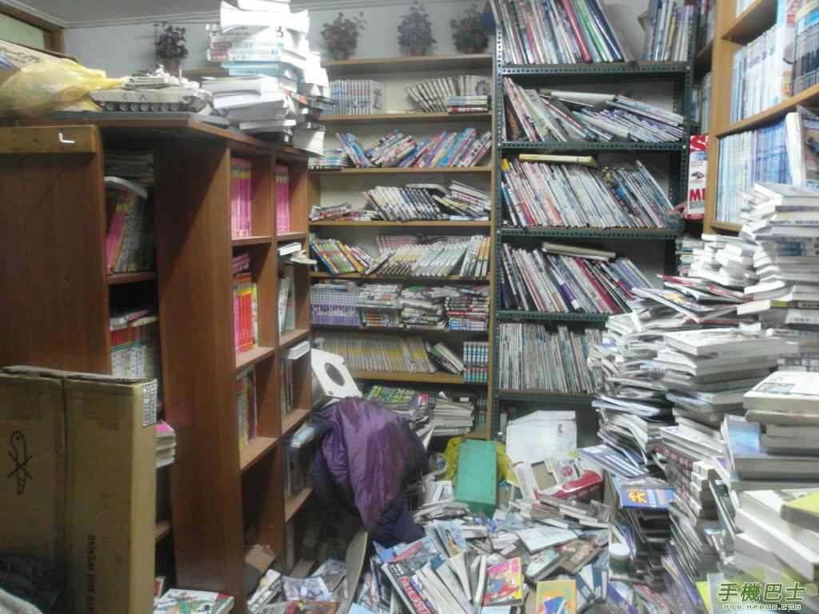
What’s the clean
Can you get the book what you want to read?

Slide 4
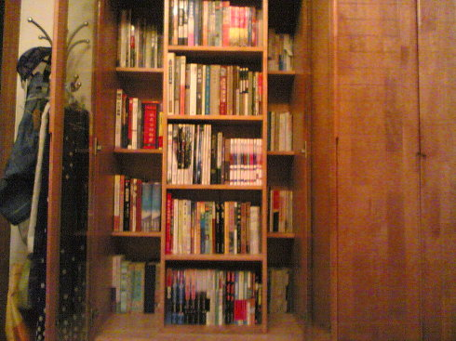
Can you get book what you want easily?

Slide 5
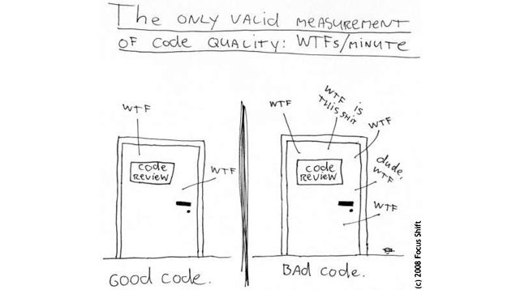
Clean Code
WTF

Slide 6
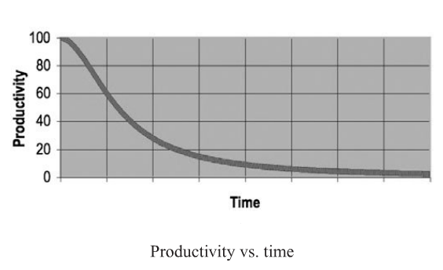
Productivity VS. Time

Slide 7
Clean code
Bjarne Stroustrup
I like my code to be elegant and efficient.
Grady Booch
Clean code is simple and direct. Clean code reads like will-written prose.
Dave Thomas
Clean code can be read, and enhanced by a developer other than its original author. It has meaningful names.

Slide 8
How to write clean codes
Name
Function
Comments
Formatting
Objects and Data Structures
Error Handling
Unit Tests

Slide 9
Name
Use Intention-Revealing Names
Avoid Disinformation
Make Meaningful Distinctions

Slide 10
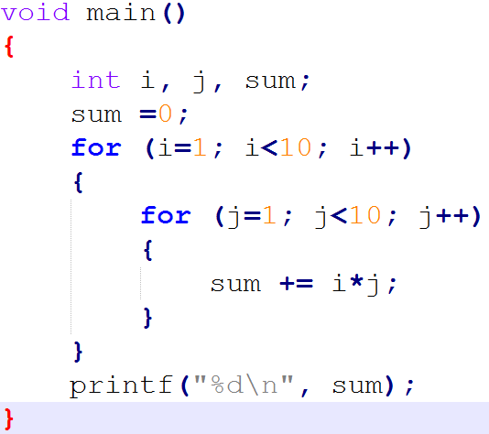
Use Intention-Revealing Names

Slide 11
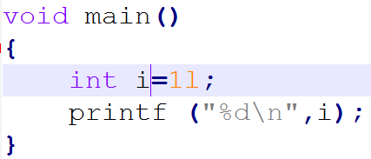
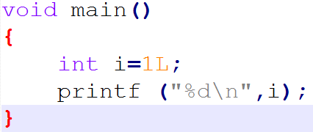
Avoid Disinformation

Slide 12
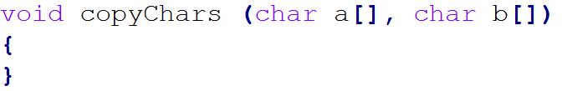
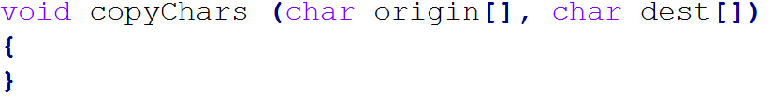
Make Meaningful Distinctions

Slide 13
Function
Small is important
Do one thing
One level of Abstraction per Function
Switch Statements
Function Arguments
Command Query Separation
Prefer Exceptions to Returning Error Codes

Slide 14
Small is very important
??
Miller
The number of objects an average human can hold in working memory is 7±2

Slide 15
Do one thing

